Slide 1

Vel Tech Rangarajan Dr. Sagunthala R&D Institute of Science and Technology
School of Computing
Department of Computer Science and Engineering
10211CS224 / FULL STACK APPLICATION DEVELOPMENT (JAVA)
PROJECT REVIEW : MILESTONE PROJECT – 1
Date: 24-03-2026
Automated Quiz Engine with PDF Certification Generation
SDG: SDG 4 – Quality Education
Presented By:
B.Rajesh kumar – VTU26008 – 23UECS0081
Courses Handling Faculty:
Dr. Hafizur Rahman – Assistant profisser

Slide 2
INTRODUCTION
In today’s digital education environment, efficient quiz evaluation systems are essential.
Traditional quiz methods are manual, time-consuming, and prone to errors.
Managing large numbers of students and evaluating answers manually is difficult.
This project aims to automate the quiz conduction and evaluation process.
It is important as it reduces human effort and improves accuracy.
The system is useful in schools, colleges, and online learning platforms.
It provides real-time result generation and performance tracking.
The proposed system is a web-based quiz engine that handles users, questions, and results dynamically.
1
2
3
4
5
6
7
8
9

Slide 3
PROBLEM STATEMENT
Existing quiz systems are often manual and require significant human effort.
Evaluating answers for a large number of students is time-consuming.
Manual processes can lead to errors and inaccurate results.
There is no efficient way to store and manage quiz data centrally.
Tracking student performance becomes difficult without automation.
Traditional systems lack real-time result generation.
This reduces efficiency and delays feedback to students.
Hence, there is a need for a reliable, automated quiz system to improve accuracy and performance
.
1
2
3
4
5
6
7
8
9

Slide 4
OBJECTIVE(S)
To design and develop a web-based quiz engine for conducting and managing online quizzes.
To implement automatic evaluation and result generation to improve accuracy and efficiency
1
2
3
4
5
6
7
8
9

Slide 5
PROPOSED SYSTEM
1
The system is a web-based quiz application that automates quiz conduction and evaluation.
It allows users to register and login securely before attempting quizzes.
Questions are stored and fetched dynamically from the database.
Users can select answers through a simple and interactive interface.
The system automatically evaluates answers and calculates scores instantly.
Results are stored and can be accessed for future reference.
It reduces manual effort and eliminates evaluation errors.
Compared to traditional systems, it is faster, more accurate, and scalable.
2
3
4
5
6
7
8
9

Slide 6
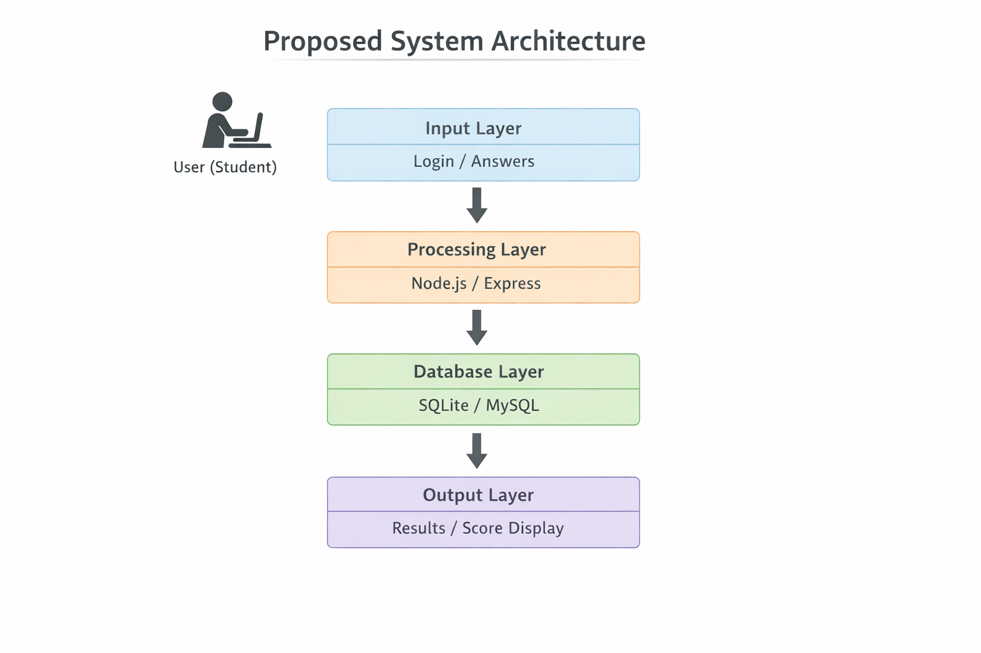
PROPOSED SYSTEM ARCHITECTURE
1
2
3
4
5
6
7
8
9

Slide 7
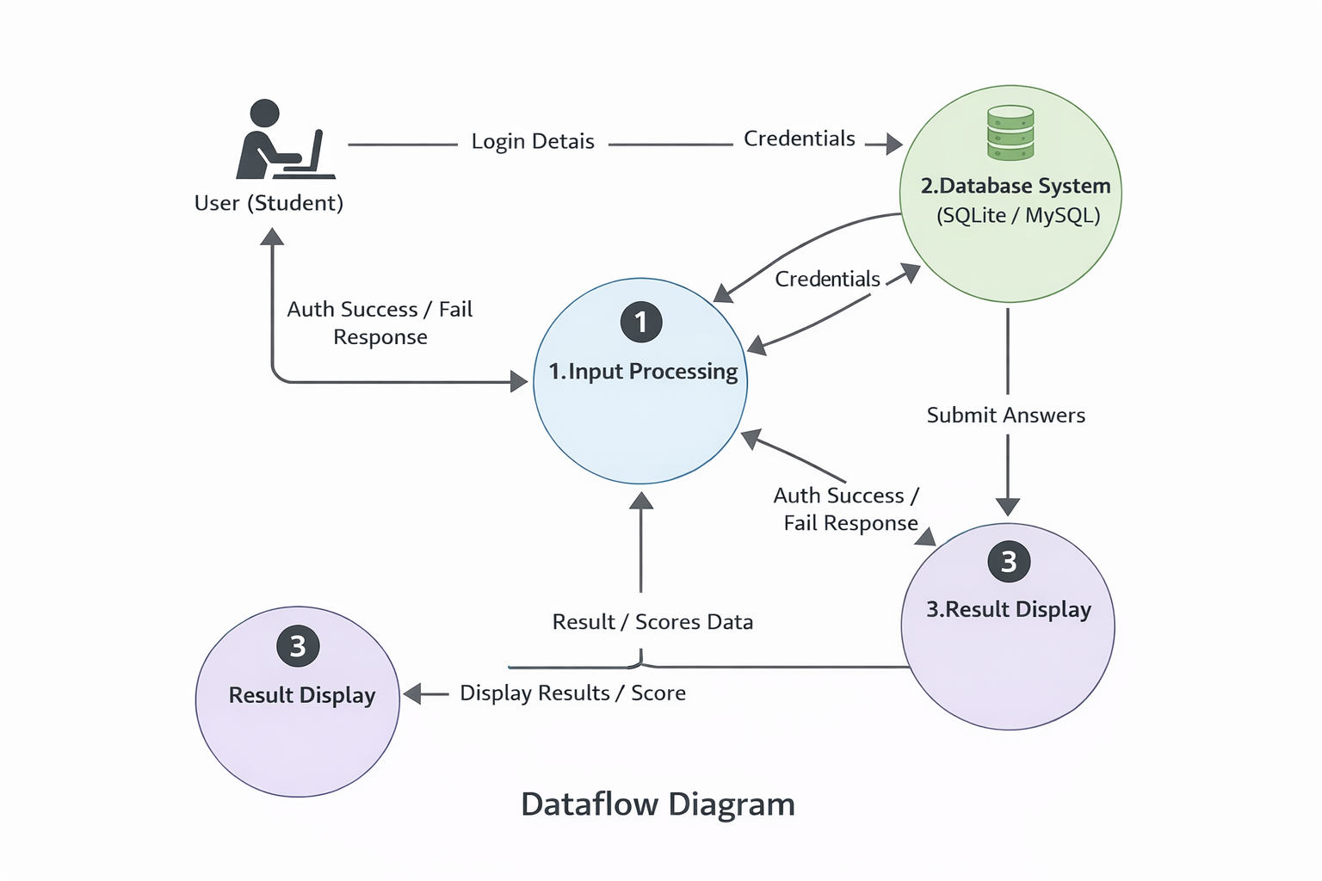
WORKFLOW
1
2
3
4
5
6
7
8
9

Slide 8
TECHNOLOGIES USED
Frontend:
React.js
Tailwind CSS
HTML5, CSS3, JavaScript (ES6)
Backend:
Node.js
Express.js
Database:
MySQL
Tools:
Visual Studio Code
Git & GitHub
XAMPP, PHP admin
Hardware/Software Requirements:
System with minimum 4GB RAM
Node.js installed
Web browser (Chrome/Edge)
Operating System (Windows/Linux/Mac)
1
2
3
4
5
6
7
8
9

Slide 9
MODULE DESCRIPTION
Module 1: User Management
Handles student registration and login with basic authentication, ensuring secure access to the quiz system.
Module 2: Quiz Management
Manages quiz questions, displays multiple-choice questions, and allows users to select answers.
Module 3: Evaluation System
Processes user responses, checks correct answers, and calculates the score automatically.data integrity.
Module 4: Result Management
Stores quiz results in the database and displays the final score with performance details.
1
2
3
4
5
6
7
8
9

Slide 10
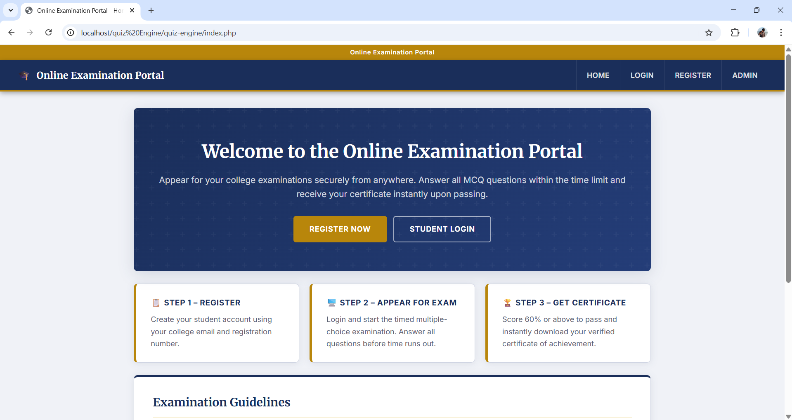
IMPLEMENTATION SCREENSHOTS
1
2
3
4
5
6
7
8
9
The image shows a web-based Online Examination Portal with options for registration and student login. It highlights a simple 3-step process: register, appear for the exam, and receive a certificate after passing.

Slide 11
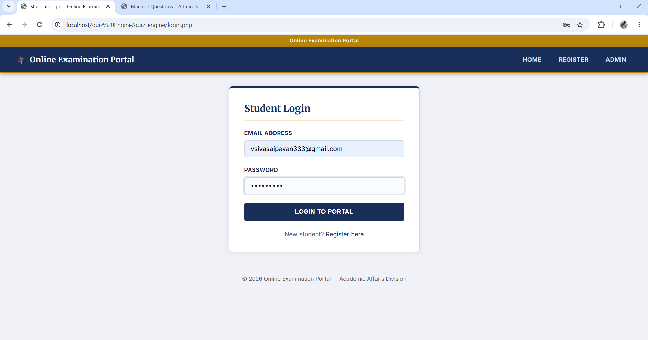
IMPLEMENTATION SCREENSHOTS
1
2
3
4
5
6
7
8(A)
9
The image shows a Student Login page of an Online Examination Portal with fields for email and password. It provides a secure access point for students to log in and take exams, along with a registration option for new users.

Slide 12
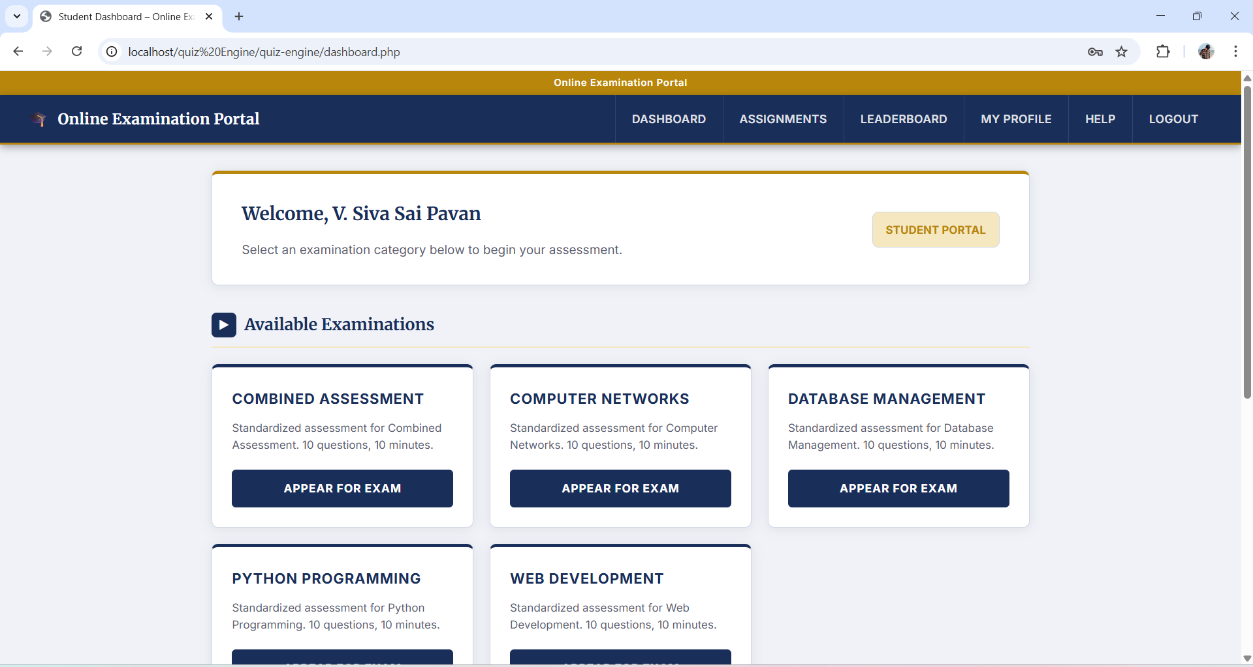
IMPLEMENTATION SCREENSHOTS
1
2
3
4
5
6
7
8(B)
9
The image shows a Student Dashboard of an Online Examination Portal with multiple exam categories available. It allows users to select and start exams like Computer Networks, DBMS, Python, and Web Development.

Slide 13
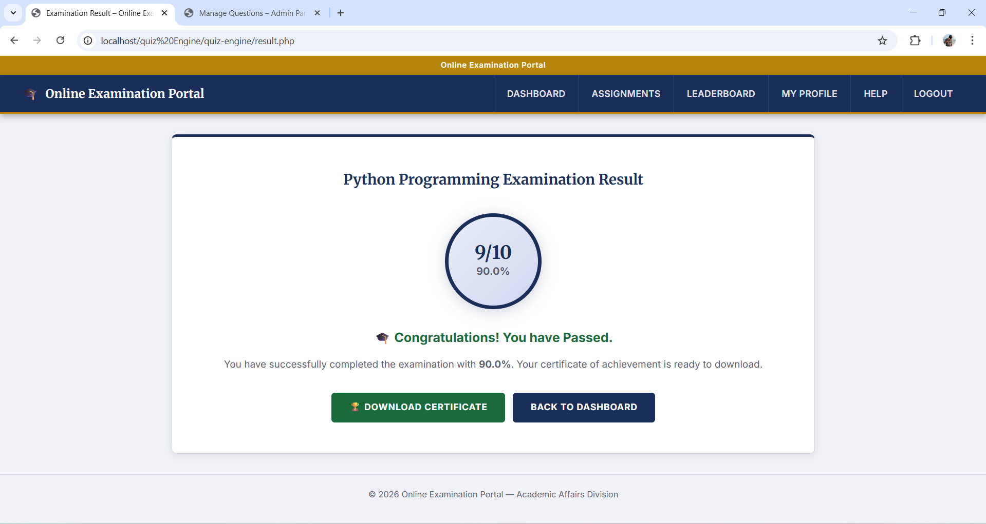
IMPLEMENTATION SCREENSHOTS
1
2
3
4
5
6
7
8(C)
The images show the exam result page displaying a score of 90% with a pass confirmation and options to download the certificate. They also include a certificate of achievement generated for the student, highlighting successful completion of the online examination.
9

Slide 14
ADVANTAGES & LIMITATIONS
Advantages
Automates quiz conduction and evaluation process
Provides fast and accurate result generation
Reduces manual effort and human errors
User-friendly and easy to use interface
Stores and manages data efficiently
Scalable for multiple users
Limitations
Requires internet connection to access the system
Basic security features (can be improved)
Limited UI design compared to advanced platforms
Uses SQLite (not suitable for very large-scale systems)
1
2
3
4
5
6
7
8
9

Slide 15
Thank you

